Slide 1
Kaizen | 改善
Instilling Continuous Ensemble Development
featuring the
Coppell HS Wind Symphony
Gerry Miller
Coordinator of Fine Arts – Coppell ISD
Director of Bands – Coppell HS

Slide 2
Thanks in advance to the student-performers of the Coppell HS Wind Symphony for generously offering their time and talent to make this presentation for the band directors and of Texas.

Slide 3
Please post your questions in the
POLL TAB
I will provide some links in the
FILE TAB

Slide 4
改善
Kaizen is a Japanese term meaning “change for the better” or “continuous improvement.” It is a Japanese business philosophy regarding the processes that continuously improve operations and involve all stakeholders. Kaizen sees improvement in productivity as a gradual and methodical process.

Slide 5
改善
The 5 key elements of Kaizen for organizations:
Teamwork
Personal Discipline
Improved Morale
Quality
Suggestions for Improvement

Slide 6
TOOLS OF
THE TRADE

Slide 7
The 3 most-important “Tools of the Trade”
HD-300 Harmony Director Keyboard
Thanks to the team at Yamaha for allowing us to test the HD-300 over the past several months –
Jonathan Goldman, Dave Gerhart, David Suter, and Chris Manners.

Slide 8
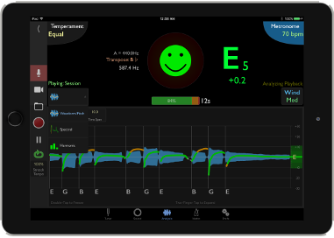
The 3 most-important “Tools of the Trade”
Tonal Energy app

Slide 9
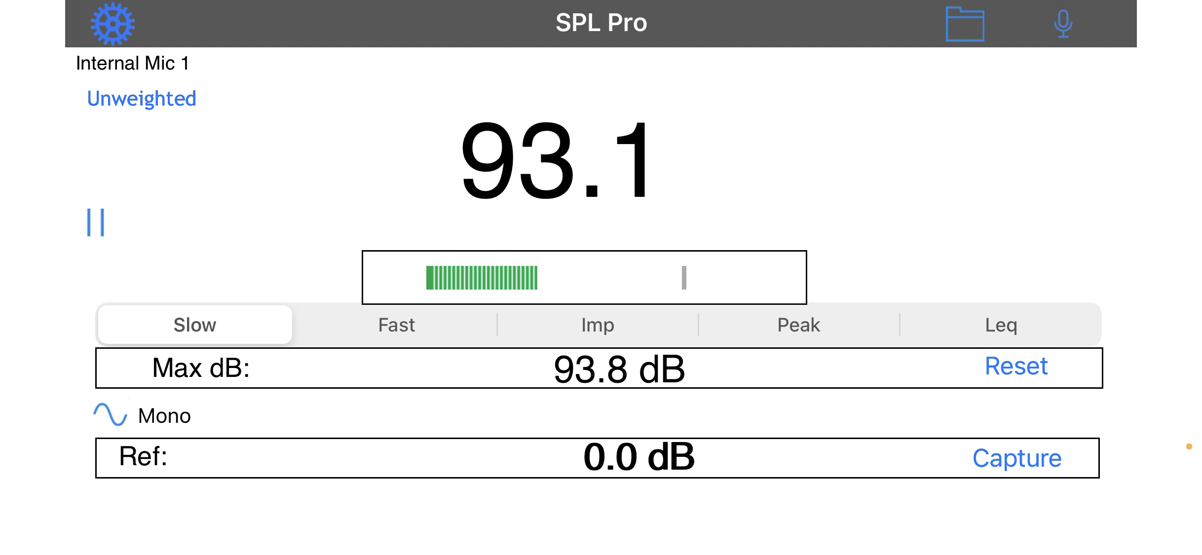
The 3 most-important “Tools of the Trade”
Decibel Meter app

Slide 10
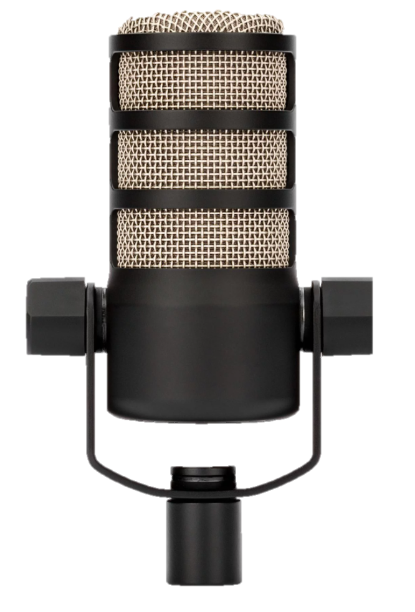
One additional tool for Virtual Instruction
PreSonus AudioBox USBi96

Slide 11
SILENCE TO SOUND

Slide 12
Sound-to-Silence and Silence-to-Sound

Slide 13
Sound-to-Silence | Silence-to-Sound
mf
mp
p
pp

Slide 14
Sound-to-Silence | Silence-to-Sound
Ensemble
Example

Slide 15
Sound-to-Silence | Silence-to-Sound
mf
mp
p
pp

Slide 16
Sound-to-Silence | Silence-to-Sound
Ensemble
Example

Slide 17
Sound-to-Silence | Silence-to-Sound
Play – Sing – Buzz – Play

Slide 18
Sound-to-Silence | Silence-to-Sound
Ensemble
Example

Slide 19
SKIPS AND
STEPS

Slide 20
Skips and Steps

Slide 21
Skips and Steps

Slide 22
Skips and Steps
Ensemble
Example

Slide 23
Skips and Steps

Slide 24
Skips and Steps

Slide 25
Skips and Steps
Ensemble
Example

Slide 26
How do we Model and Assess?
The Harmony Director models…
In Tune
In Tone
In Time
The Decibel app measures…
Full Ensemble Volume
Section Volume
Individual Volume
The Tonal Energy app analyzes…
Individual Tuning
Individual Timing
Individual Note Shape

Slide 27
INSTILLING
PURE TEMPERAMENT

Slide 28
Instilling Pure Temperament

Slide 29
Instilling Pure Temperament

Slide 30
Instilling Pure Temperament
1
0.0₵
2
+3.9₵
3
-13.7₵
4
-2.0₵
5
+2.0₵
6
-15.6₵
7
-11.7₵

Slide 31
Instilling Pure Temperament
Preferred Voicing

Slide 32
Instilling Pure Temperament
Preferred Voicing

Slide 33
Instilling Pure Temperament
Preferred Voicing

Slide 34
Instilling Pure Temperament
Ensemble
Example

Slide 35
SEGMENTATION
AND DIVISION

Slide 36
Segmentation and Division

Slide 37
Segmentation and Division
Start – Middle – End

Slide 38
Segmentation and Division
1
2
3
4
1
forte
mp
niente

Slide 39
Segmentation and Division
1
2
3
4
1
forte
mp
niente

Slide 40
Segmentation and Division
1
2
3
4
1
forte
mp
niente

Slide 41
Segmentation and Division
1
2
3
4
1
forte
mp
niente

Slide 42
Segmentation and Division
1
2
3
4
1
forte
mp
niente

Slide 43
Segmentation and Division
1
2
3
4
1
forte
mp
niente

Slide 44
Segmentation and Division
1
2
3
4
1
forte
mp
niente

Slide 45
Segmentation and Division
1
2
3
4
1
forte
mp
niente

Slide 46
Segmentation and Division

Slide 47
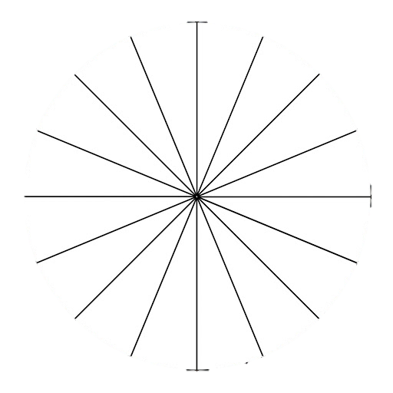
Segmentation and Division

Slide 48
Thanks to MY COLLEAGUES
Adrian Caswell Brandon Slovak Kate Klontz Annie Chernow Matthew Rummel Randall Nguyen Rusty Gray Josh Boyd Jeremy Lindquist Allie Guinn Greg McCutcheon Chantal Hoang Bona Coogle Aaron Coronado
Cecilia Hamilton Sally Bohls Sara McCallum Matthew Casazza Christy Springer Jared Hunt Andrea Denis Jon Bohls Blake Birmingham Jung Moo Lee Doug Bush Patricia Islas

Slide 49
Thanks to THE COPPELL HS WIND SYMPHONY
Flute
Lindsey Won
Akshara Sankar
Crystal Suk
Eden Kim
Anish Singhal
Hyewon Youn
Esther Han
Oboe
Anvita Ukidwe
Samidha Menon
Andrew Cai
Bassoon
Sahan Yerram
Wes Booker
Shreya Premkumar
Clarinet
Raghav Vemuganti
Joshua Chio
Areebah Syed
Marcus Jarvela
Mehak Arora
Matthew Palwecki
Bass Clarinet
Muhtasim Mahfuz
Prerana Kalapatapu
Saxophone
Arnav Mazumder
Christine Xu
Nathan Crawford
Brink van Eeden
Trumpet
Anushri Saxena
Zain Zaidi
Brandon Dastur
Connor Gilbert
Hamza Hussain
Dasha Ellalasingham
Srikar Gade
Aaron Balsamo
Horn
Neha Bharadwaj
Arya Agiwal
Lindsey Magee
Owen Clark
Trombone
Wyatt Andrews
Avery Owens
Hannah Christudass
Avik Malladi
Troy Angulo
Delase Ansah
Euphonium
Harini Lenin
Josphin Kallery
Aashi Lala
Tuba
Shray Shine
Rohan Kanjani
Brenten George

Slide 50
Kaizen | 改善
Comments? Questions?
Click on the link in the Clinic Record to join you for the live Q&A session that will begin shortly.

