Slide 1
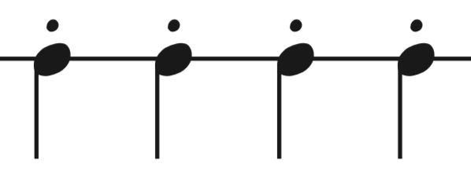
Note Shapes
1
2
3
4
1
forte
mp
niente

Slide 2
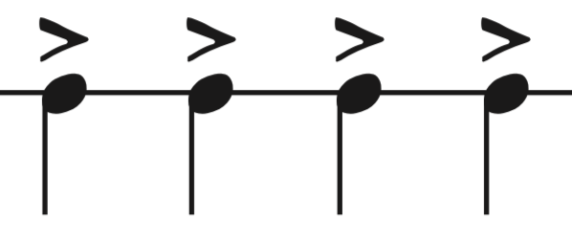
Note Shapes
1
2
3
4
1
forte
mp
niente

Slide 3
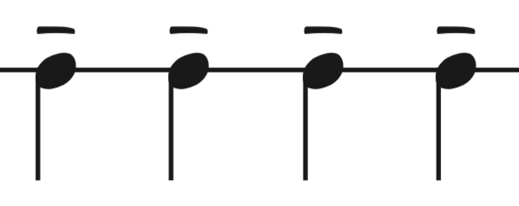
Note Shapes
1
2
3
4
1
forte
mp
niente

Slide 4
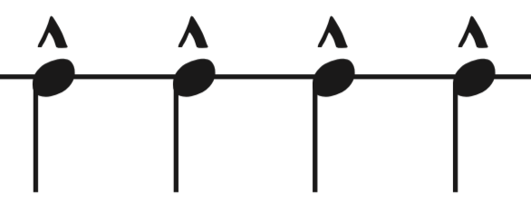
Note Shapes
1
2
3
4
1
forte
mp
niente

Slide 5
Note Shapes
Which shape do you think this is?
STACCATO

Slide 6
Note Shapes
Which shape is this?
ACCENTED

Slide 7
Note Shapes
Now, can you guess which shape this is?
TENUTO

