Slide 1
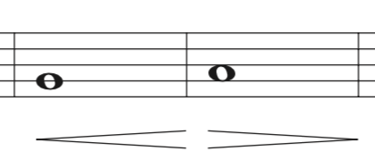

Slide 2
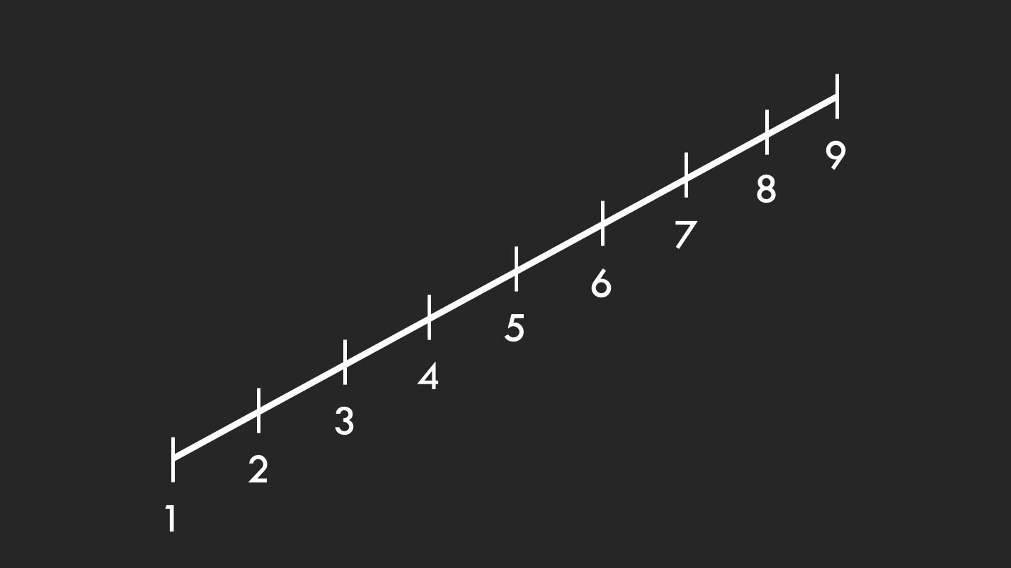
Straight-line Crescendo

Slide 3
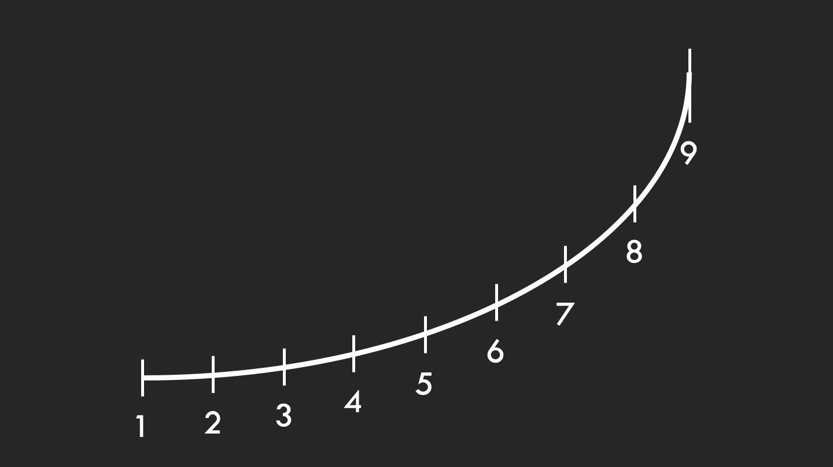
Correct Crescendo
a la “airplane take-off”

Slide 4
Correct Crescendo
a la “airplane take-off”
soprano
alto
tenor
bass

Slide 5
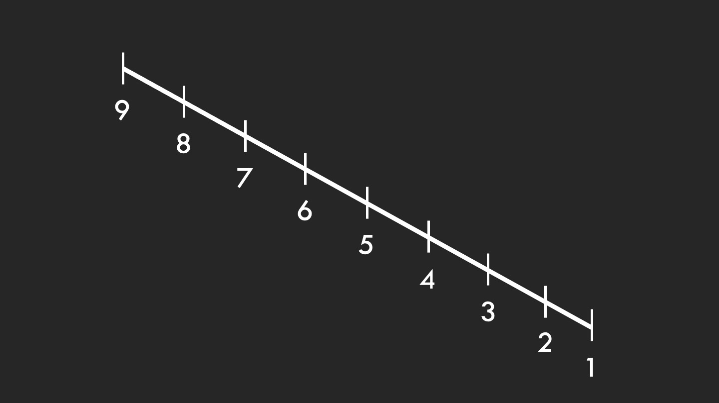
Straight-line Diminuendo

Slide 6
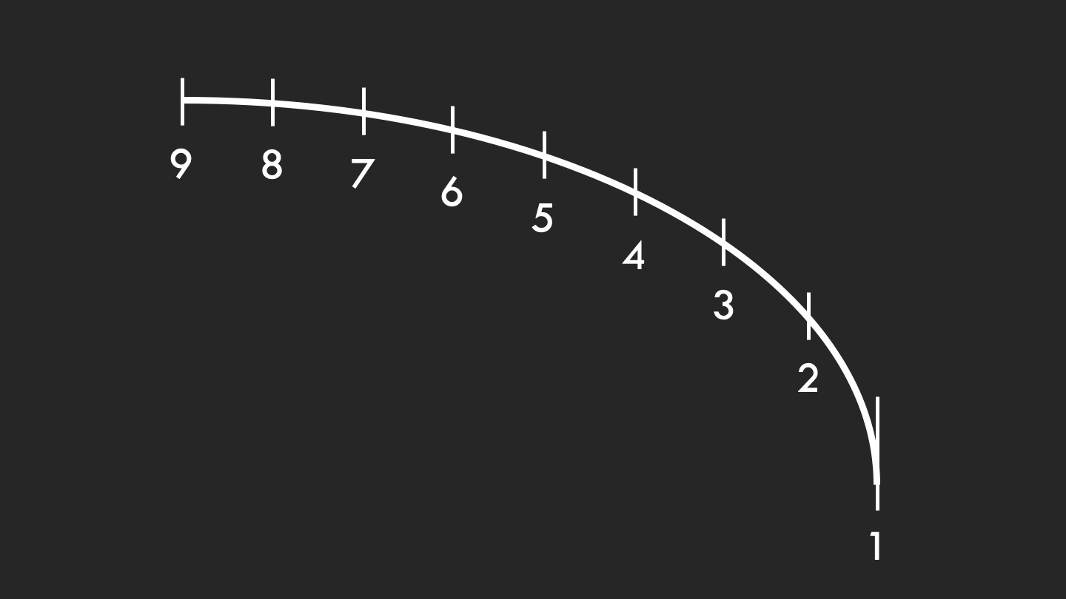
Correct Diminuendo

Slide 7
Correct Diminuendo
soprano
alto
tenor
bass

Slide 8
Traditional Crescendo into a Decrescendo

Slide 9
Correct Crescendo into a Decrescendo

Slide 10
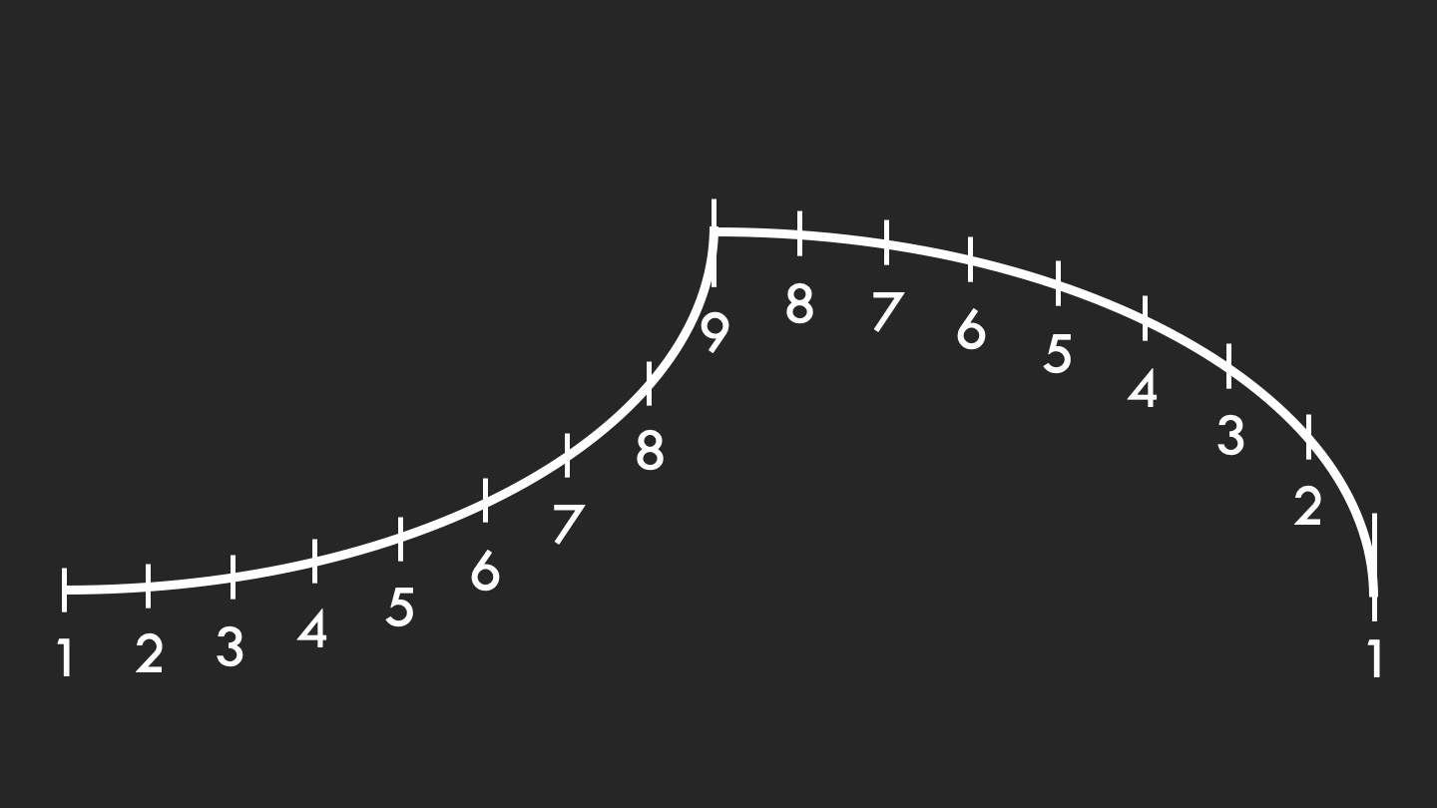
Correct Crescendo into a Decrescendo
with timing

Slide 11
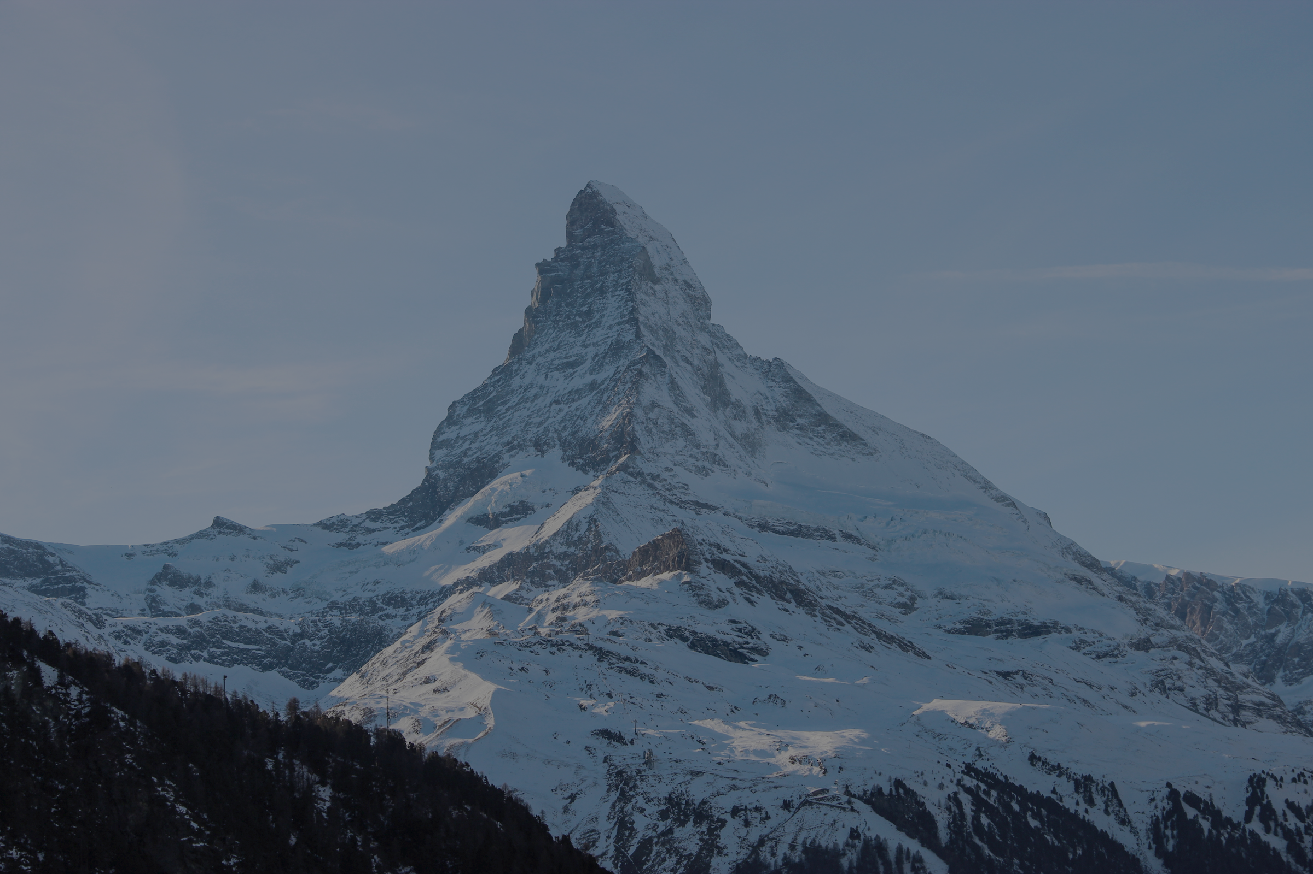
Correct Shaping is Organic
soprano
alto
tenor
bass

